Slide 1
A Brief Introduction to Kanban
Mike Harris – Software Engineering Lead, SSRN
Empowering Knowledge
Notes:
Welcome!

Slide 2
Who am I?
Mike Harris, Software Engineering Lead, SSRN, Elsevier.
Joined SSRN Team in April 2017.
Became the lead in February 2018.
Graduated with degree in Computing for Real-Time Systems back in 1993.
Worked with lots of programming languages over the years, including C++, Java, Perl, PHP, JavaScript and COBOL.
Got seriously into Agile/Lean/XP over the last six years.

Slide 3
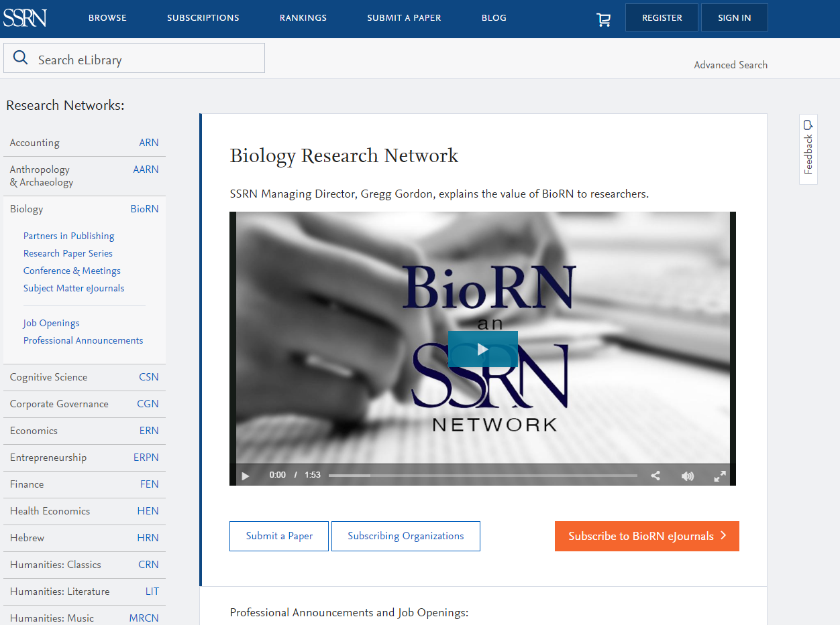
What is SSRN?
SSRN is the Social Science Research Network
It is a Pre-print Server
It Allows researchers to share their preprints or working papers to accelerate dissemination of their ideas, lay claim to those ideas, and to get feedback on their papers before they submit them to journals.
The term Working Paper Repository is now preferred.
We are moving from Social Science Research Network to SSRN as a brand. We’ve launched Biology Research Network, Chemistry, Mathematics and Computer Science, Women and Gender Studies networks, and are launching many, many more this year.

Slide 4
High level deliverables
Continue to improve and expand the current SSRN to grow our Monthly Active Users and hit our Revenue targets
Build a great team based in Oxford to help us work on the product integration and migration of SSRN within Elsevier
Make the new and improved version of SSRN a valuable part of both ROS and the broader Elsevier ecosystem
Build out the Social use case for SSRN to help expand the ROS audience and grow our research community
Notes:
I think it's good to highlight that we have two jobs - to continue to improve the current SSRN with you (ITX), and to build a new team that brings SSRN into Elsevier.
So there's lots to do, and like any big project it's not without risk…
HERE ARE THREE I RISKS I WANTED TO HIGHLIGHT TODAY...

Slide 5
How we’re doing it
Internet
Load Balancer
Search Service
Authors Service
Cold Fusion
Web Server
ES
EC2
EC2
PG
Kinesis
Paper Service
Events
New Platform (Microservices)
MySQL
Oracle
PG
EC2
Existing Platform (Monolithic)

Slide 6
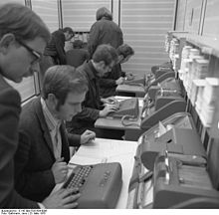
The techniques we are using
Scrum – retrospectives, planning, stand-ups
Lean – Kanban
Test Driven Development (TDD) – contract, system, functional, integration and unit tests
Clean Code
SOLID principals
Domain driven design
Pair programming
Mob programming

Slide 7
Technologies we are using
Amazon Web Services (AWS)
ElasticCloud 2 (EC2)
Kinesis
Realtime Data Services (RDS)
S3
ElasticSearch
DynamoDB
Lambda
CloudWatch
Java 8
JetBrains IntelliJ IDEA
Docker and Amazon ECS
Linux
Python and Fabric for deployment
Terraform for infrastructure
GoCD for continuous deployment and continuous integration

Slide 8
What is Kanban?
Scheduling system originally for Lean Manufacturing
Devised originally by Taiichi Ohno at Toyota
As a method to achieve JIT Manufacturing
Helps establish WIP limits
Helps identify waste in a process
Waste being unfinished work in queues waiting to be done
Kanban is therefore all about the queues
看板

Slide 9
Scrum vs Kanban

Slide 10
Scrum vs Kanban: Kanban boards
Queues
WIP Limits

Slide 11
ScrumBan
Do daily stand-ups
Hold frequent Retrospectives
Consider holding short planning to cover what may be done in next iteration.
Use WIP limits.
Reprioritise as and when.
Release as and when.
Hold Grooming Workshops in the background.

Slide 12
Stand-up: Tips
Make sure they happen at the same time every day.
Each person should speak for maximum of one minute.
Keep it high-level: not too technical.
Cover of what you’ve done, what you’re going to do today, and what your blockers are.
Take any issues or deeper discussions out of stand-up.
Walk the wall if you prefer, from right to left.
Take it in turns who starts or who facilitates walking the wall.
Do not be late!
Do not be distracted!
Do not waffle!

Slide 13
Retrospective: Tips
Make sure they happen at the same time.
Make sure everyone on the team is involved.
Do them frequently: every fortnight at least, or every week if required.
Keep them short and sweet: one hour maximum.
Ensure you take actions.
Ensure you cover off the actions from previous retro first.
Rotate who facilitates the retro.
Try different types of retro: the boat, sad-glad-mad, good-meh-bad, thinking hats, Boston Box
Try different themes: batman, retro gaming, anime, game of thrones…
Try limiting number of tickets people can place.
Try limiting number of votes.

Slide 14
Kanban board: Tips
Use WIP limits.
Make sure all work is on the board.
Be prepared to iterate the board, changing it as necessary.
Everyone owns the board and keeps it up to date.
Use colour coded cards to mark different streams of work.
Use swim lanes where applicable, and to aid all work being on the board.

Slide 15
Development team XP: Tips
Devs do QA.
Devs do DevOps.
Do pair programming as and when possible.
Even do mob programming where is makes sense.
Favour the Agile principals of Working Software over Documentation and Customer Collaboration over Contract Negotiation.
Have a physical board (as well as virtual board).
Remember that the important focus is the queues.

Slide 16
Thanks
m.harris@elsevier.com
https://ssrn.com

